Slide 1
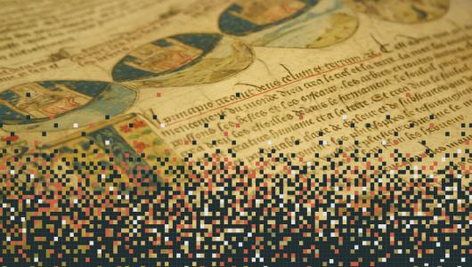
Final Lesson
12 May 2023
Practical Organization (work schedule in Bologna)
LEARNING AND TRAINING
ERASMUS+ BLENDED INTENSIVE PROGRAMME 2022/23
PART A: SHARED ON-LINE LESSONS (20 March-12 May)
Digitizing a Lexicon. How to Work with Words for the Study of Religions in the Graeco-Roman World
Seminar cycle planned for the Master's Degree in Historical and Oriental Sciences, University of Bologna (20 March-27 May)
Valid for the acquisition of Seminar CFUs as a closed-loop Seminar [6 ECTS]
Proposing lecturer: prof. Giuseppina Paola Viscardi
Giuseppina Paola Viscardi

Slide 2
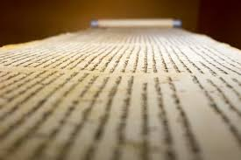
FOREIGN STUDENTS
Iida Huitula, University of Helsinki
Jamie Vesterinen, University of Helsinki
Haowei Zhang, Universität Bielefeld
Johannes Heinrich Zils, Universität Bielefeld
Rafael Rodríguez Pérez, Universidad de Sevilla – US (PhD)
Silvia Ghedini, Universidad Pablo de Olavide de Sevilla – UPO (PhD)
Esperanza Ródenas, Universidad Pablo de Olavide de Sevilla – UPO (PhD)
Laura Ramos Martínez, Universidad Pablo de Olavide de Sevilla – UPO (PhD)
Alexandre Morón, Universidad Carlos III de Madrid (Universidad de Santiago de Compostela – USC)
Paula Somas Sánchez, Universidad Carlos III de Madrid
Sara Escudero Bados, Universidad Carlos III de Madrid,
Leire Moro Arana, Universidad Complutense de Madrid,
Aitor Boada Benito, Universidad Complutense de Madrid
Blas Bouza Moares, Universidad Complutense de Madrid
Mateusz Kula, Jagiellonian University of Kraków (PhD)
Sławomir Bobola, Jagiellonian University of Kraków (PhD)
Alicja Trubas, Jagiellonian University of Kraków,
Gabriela Szczepanik, Jagiellonian University of Kraków
Alicja Marczewska, Jagiellonian University of Kraków
ITALIAN STUDENTS
Caterina Borgatti (SSO) > teleo/telesthai/telestiké
Gabriella Lanziani (SSO) > signum
Eva Zanfi (SSO) > cherem
Francesca De Lorenzi (Filologia) > miraculm
Maria Chiara Bruni (Filologia) > anathema
Lucia Maglianesi (Italianistica) > prodigium
Daniela Miccoli (Storia-Triennale) > augur
LIST OF STUDENTS PARTICIPATING IN ERASMUS + BLENDED INTENSIVE PROGRAM "DIGITIZING A LEXICON"

Slide 3
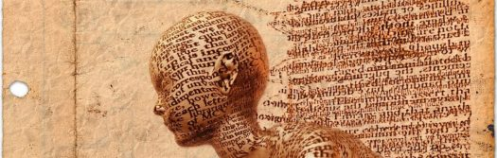
LEXICAL ENTRIES’ SELECTION
BOLOGNA RESEARCH TEAM
Daniela Miccoli (Storia): AUGUR
Caterina Borgatti (SSO): TELESTIKÉ
Lucia Maglianesi (Italianistica): TERAS/PRODIGIUM
Francesca De Lorenzi (Filologia): MIRACULUM
Gabriella Lanziani (SSO): SEMA/SIGNUM
Eva Zanfi (SSO): CHEREM
Maria Chiara Bruni (Filologia): ANATHEMA

Slide 4
Implementation of at least 15 lexical entries on the word sheet
Indexing
Digitization
Expected Results
During the morning (h. 9-12):
Library research
Finalization of data sheets
Two theoretical lectures by external scholars working on Lexicons and Etymological Dictionaries to be arranged
During the afternoons (h. 14-17)
Digitization of data sheets
Work organization in Bologna

Slide 5
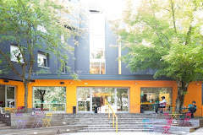

Your accommodation in Bologna
Combo, Bologna
Address: Via de' Carracci, 69/14, 40129 Bologna BO
Telephone number: +39 051 039 79 00
https://thisiscombo.com/it/location/combo-bologna/

Slide 6
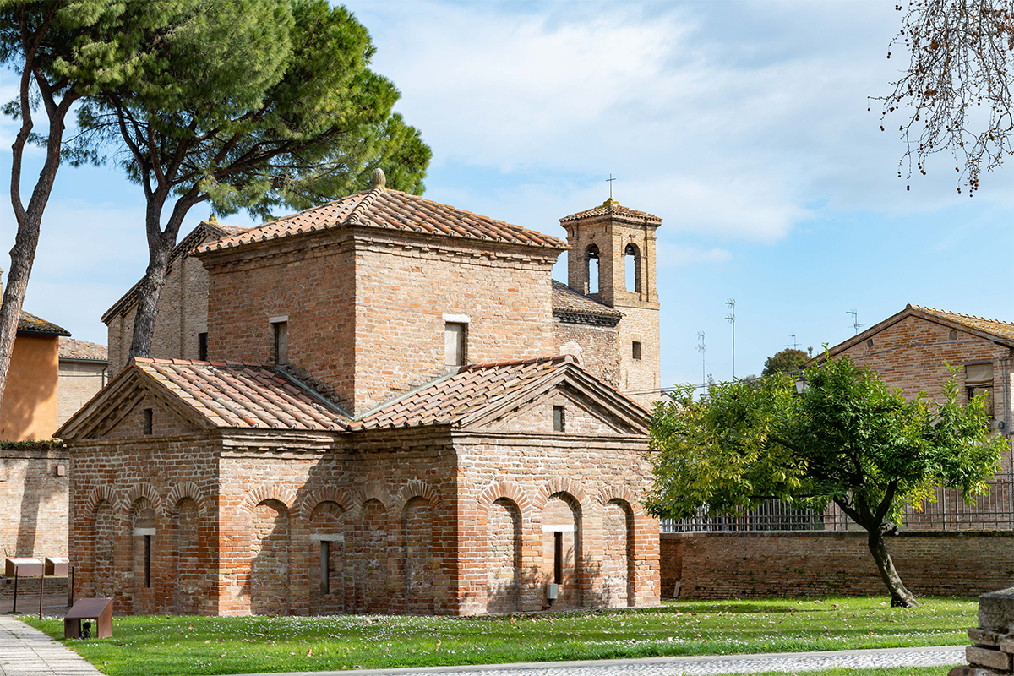
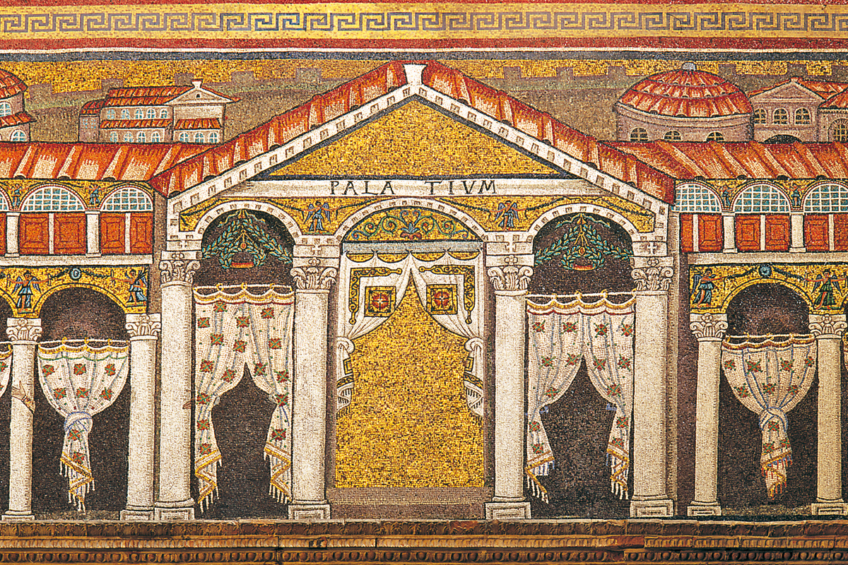
Guided tour of the city of Ravenna
Friday, May 26
Departure at 9:00 a.m. from Bologna Central Station
Return at 5:00 p.m.
Unesco Monuments
Mausoleo di Galla Placidia
Basilica di Sant’Apollinare Nuovo
https://www.turismo.ra.it/follow-your-way/monumenti-unesco/

